Slide 1
8.4 paging
Paging is a memory-management scheme that permits the physical address space of a process to be non-contiguous.
The basic method for implementation involves breaking physical memory into fixed-sized blocks called FRAMES and break logical memory into blocks of the same size called PAGES

Slide 2
Paging
Every address generated by the CPU is divided into two parts: Page number (p) and Page offset (d)
The page number is used as an index into a Page Table

Slide 3
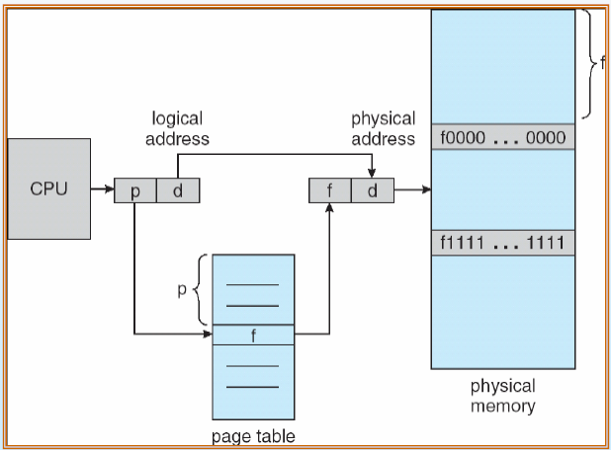
Paging

Slide 4
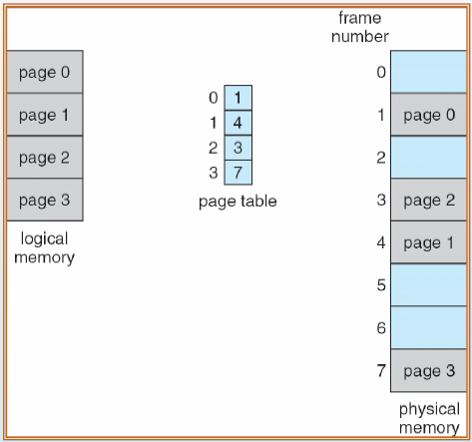
Paging

Slide 5
Paging
The page size is defined by the hardware
The size of a page is typically a power of 2, varying between 512 bytes and 16MB per page
Reason: If the size of logical address is 2^m and page size is 2^n, then the high-order
m-n bits of a logical address designate the page number

Slide 6
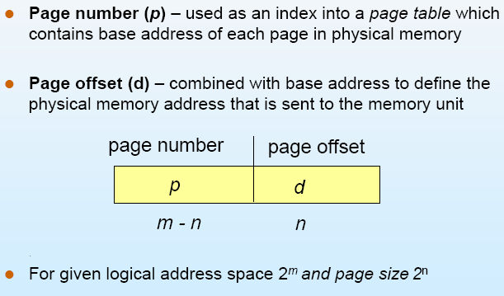
Paging

Slide 7
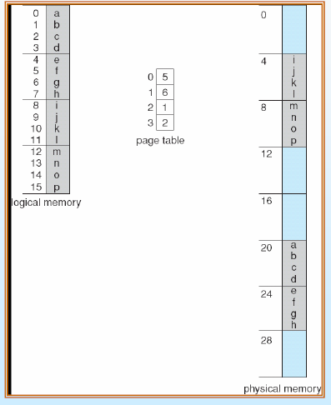
Paging Example

Slide 8
Paging
When we use a paging scheme, we have no external fragmentation: ANY free frame can be allocated to a process that needs it.
However, we may have internal fragmentation
For example: if a page size is 2048 bytes, a process of 72766 bytes would need 35 pages plus 1086 bytes

Slide 9
Paging
If the process requires n pages, at least n frames are required
The first page of the process is loaded into the first frame listed on free-frame list, and the frame number is put into page table

Slide 10
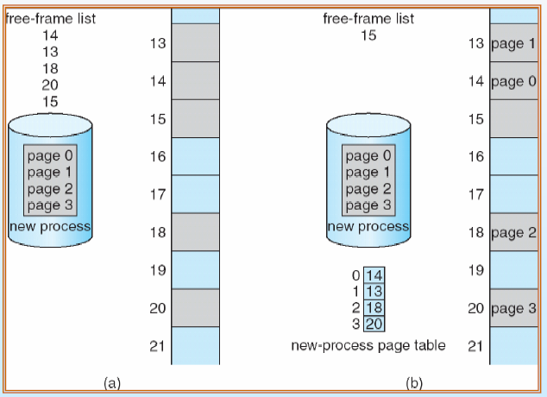
Paging

Slide 11
Hardware Support on Paging
To implement paging, the simplest method is to implement the page table as a set of registers
However, the size of register is limited and the size of page table is usually large
Therefore, the page table is kept in main memory

Slide 12
Hardware Support on Paging
If we want to access location I, we must first index into page table, this requires one memory access
With this scheme, TWO memory access are needed to access a byte
The standard solution is to use a special, small, fast cache, called Translation look-aside buffer (TLB) or associative memory

Slide 13
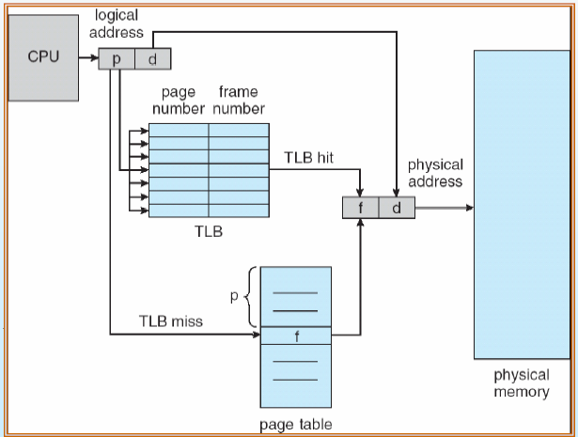
TLB

Slide 14
TLB
If the page number is not in the TLB (TLB miss) a memory reference to the page table must be made.
In addition, we add the page number and frame number into TLB
If the TLB already full, the OS have to must select one for replacement
Some TLBs allow entries to be wire down, meaning that they cannot be removed from the TLB, for example kernel codes

Slide 15
TLB
The percentage of times that a particular page number is found in the TLN is called hit ratio
If it takes 20 nanosecond to search the TLB and 100 nanosecond to access memory
If our hit ratio is 80%, the effective memory access time equal:
0.8*(100+20) + 0.2 *(100+100)=140
If our hit ratio is 98%, the effective memory access time equal:
0.98*(100+20) + 0.02 *(100+100)=122
(detail in CH9)

Slide 16
Memory Protection
Memory protection implemented by associating protection bit with each frame
Valid-invalid bit attached to each entry in the page table:
“valid” indicates that the associated page is in the process’ logical address space, and is thus a legal page
“invalid” indicates that the page is not in the process ’logical address space

Slide 17
Memory Protection
Suppose a system with a 14bit address space (0 to 16383), we have a program that should use only address 0 to 10468. Given a page size of 2KB, we may have the following figure:

Slide 18
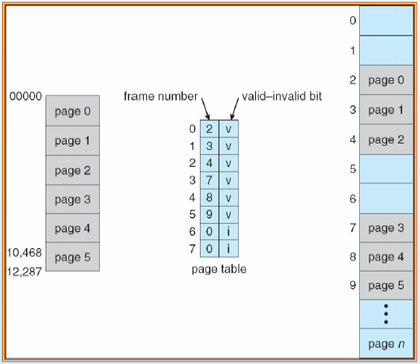
Memory Protection

Slide 19
Memory Protection
Any attempt to generate an address in page 6 or 7 will be invalid
Notice that this scheme allows the program to access 10468 to 12287, this problem is result of the 2KB page size and reflects the internal fragmentation of paging

Slide 20
Shared Pages
An advantage of paging is the possible of sharing common code, especially time-sharing environment
For example a server with 40 user using text editor (with 150k reentrant code and 50k data space)
In next figure, we see three page editor with 50k each. Each process has its own data page

Slide 21
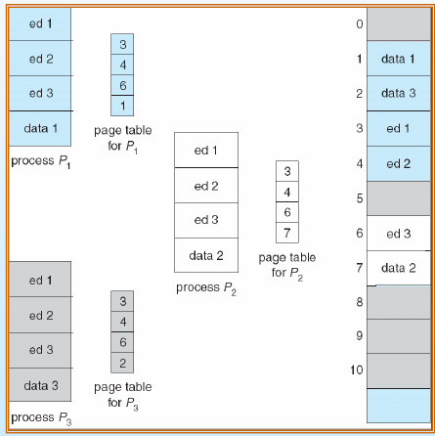
Shared Pages

Slide 22
Shared Pages
In this case, we need only
150k + 40* 50k = 2150 KB
Instead of
(150k + 50K)*40 = 8000KB

Slide 23
8.5 Structure of Page Table
Consider a system with 32-bit logical address space.
If the page size is 4 KB (2^12), then the page table may consist of up to 1 million entries (2^32/2^12=2^20)
Clearly, we would not want to allocate the page table contiguously in main memory

Slide 24
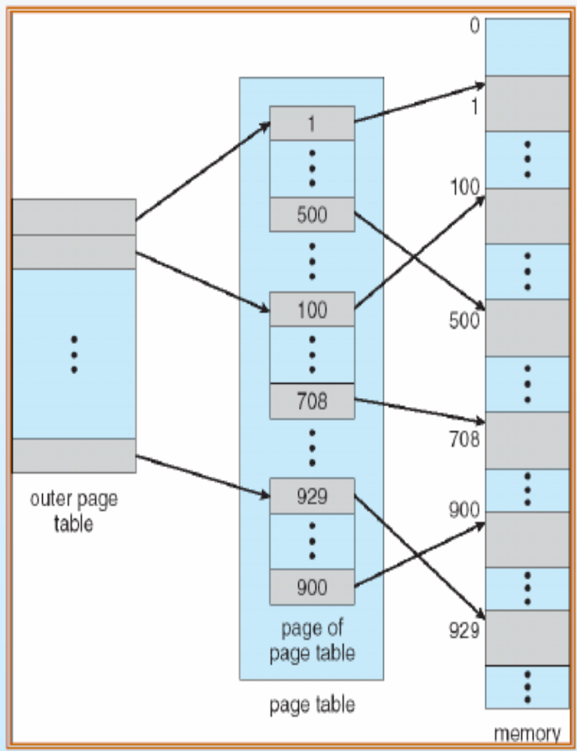
Hierarchical paging
One way is to
use a two-level
paging algorithm

Slide 25

Hierarchical paging
Remember the example is a 32-bit machine with a page size of 4 KB.
A logical address is divided into a page number consisting of 20 bits and a page offset consisting of 12 bits
10 10 12

Slide 26
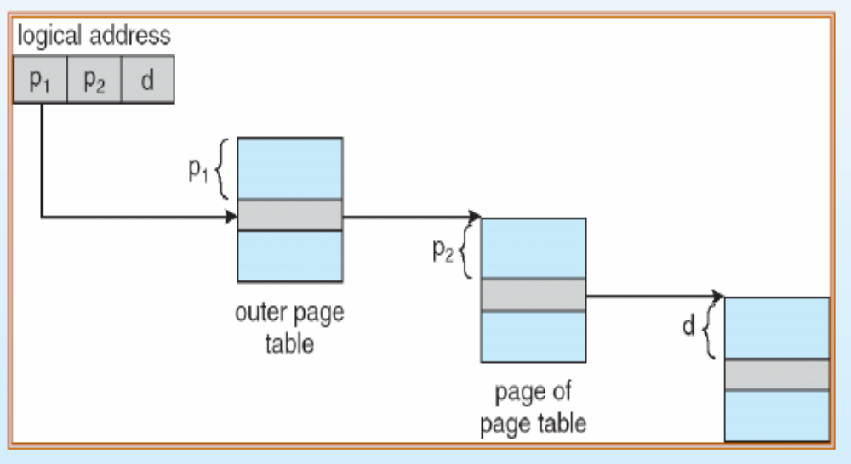
Hierarchical paging
Address translation scheme:

Slide 27
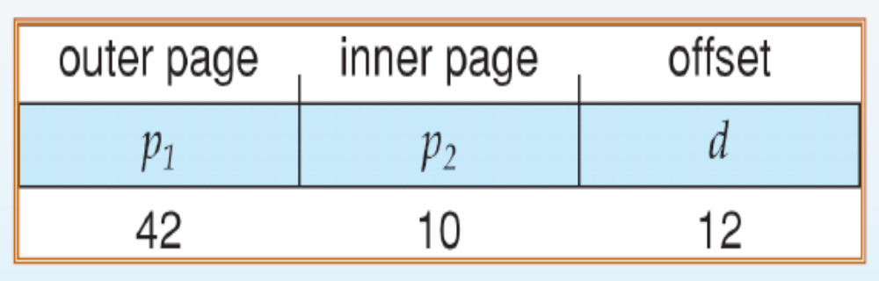
Hierarchical paging
For a system with 64-bit system, by the same scheme with page size=4KB will looks like:

Slide 28
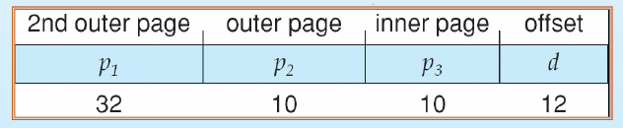
Hierarchical paging
One way to avoid such large table is to further divide the outer table into smaller pieces:

Slide 29
Hierarchical Paging
The next step would be a four-level paging scheme…
However, for 64-bit architecture, hierarchical page table are generally considered inappropriate

Slide 30
Hash Page Table
Hash Page table is commonly used in systems with address spaces larger than 32 bit
So what is a hash table?

Slide 31
Hash Page Table
Each element consists of three fields:
The virtual page number
The value of the mapped page frame
A pointer to the next element

Slide 32
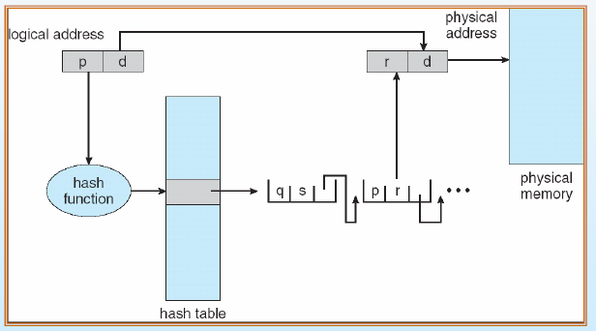
Hash Page Table

Slide 33
8.6 Segmentation
Since the user’s view of memory is not the same as the actual physical memory, segmentation helps user to view memory as a collection of variable-size segment
Segmentation is a memory management scheme that supports user view of memory

Slide 34
Segmentation
A program is a collection of segments. A segment is a logical unit such as:
main program,
procedure,
function,
method,
object,
local variables, global variables,
common block,
stack,
symbol table, arrays

Slide 35
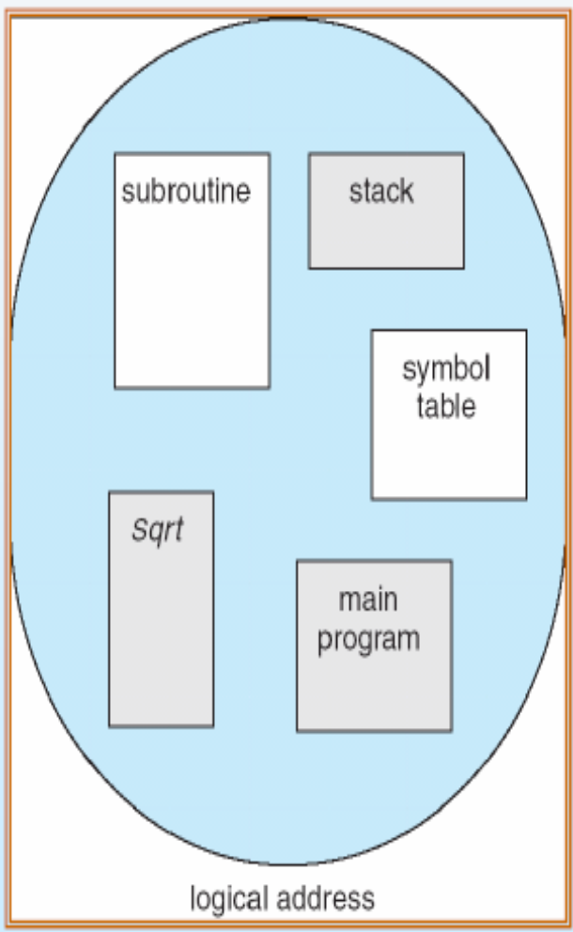
Segmentation

Slide 36
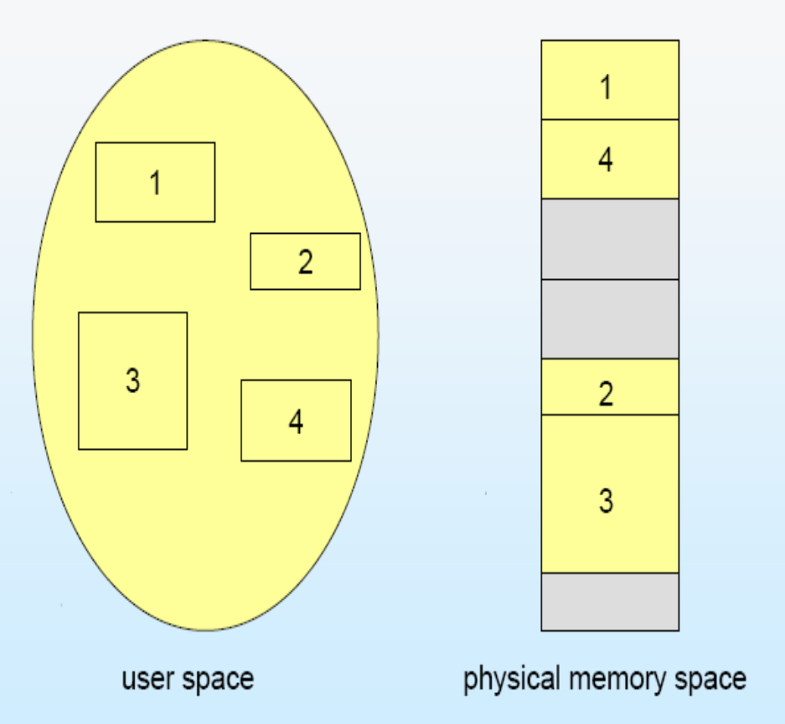
Segmentation

Slide 37
Segmentation
The user specifies each address by two quantities: a segment name and an offset
<segment-number, offset>
Compare with page scheme, user specifies only a single address, which is partitioned by hardware into a page number and an offset, all invisible to the programmer

Slide 38
Segmentation
Although the user can refer to objects in the program by a two-dimensional address, the actual physical address is still a one-dimensional sequence
Thus, we need to map the segment number
This mapping is effected by a segment table
In order to protect the memory space, each entry in segment table has a segment base and a segment limit

Slide 39
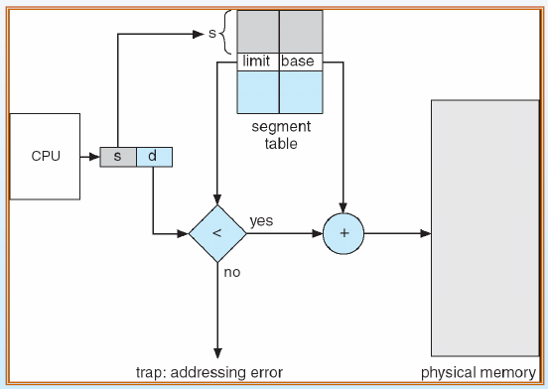
Segmentation Hardware

Slide 40
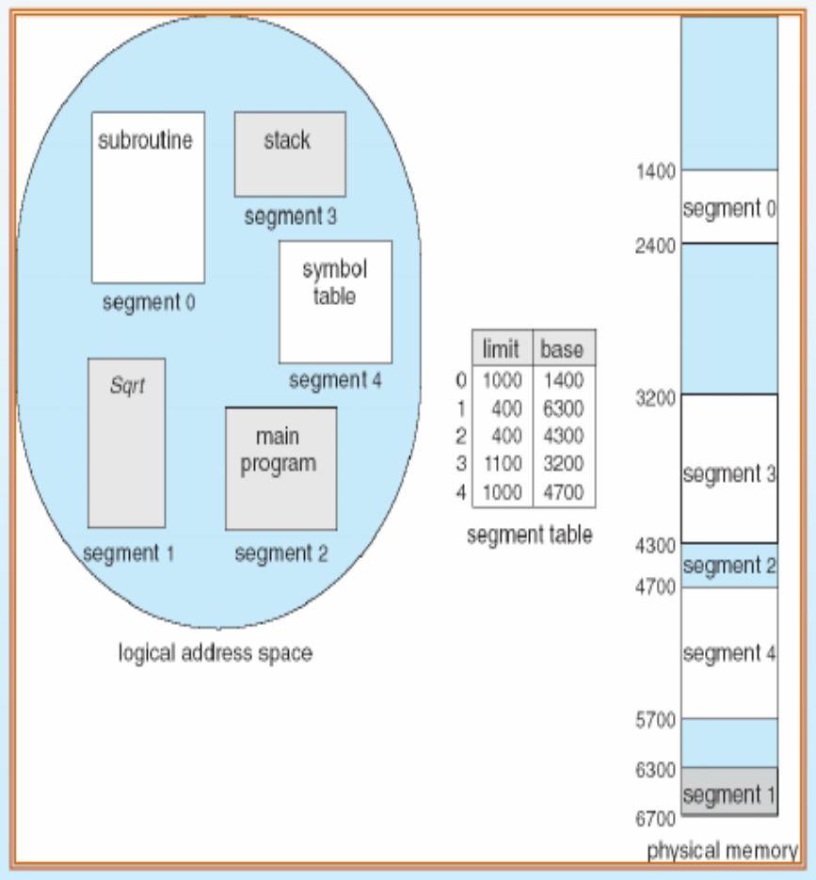
Example of Segmentation
For example, segment 2 starts from 4300 with size 400, if we reference to byte 53 of segment 2, it mapped to 4335
A reference to segment 3, byte 852?
A reference to segment 0, byte 1222?

Slide 41
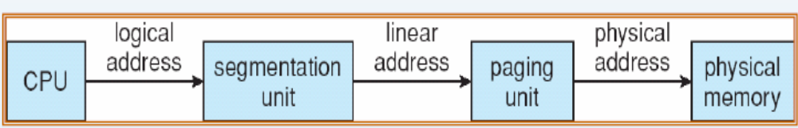
8.7 Example: Intel Pentium
In Pentium system, the CPU generates logical address, which are given to the segmentation unit
The segmentation unit produces a linear address for each logical address
Then the linear address is then given to paging unit, which in turn generates the physical address in main memory.

Slide 42
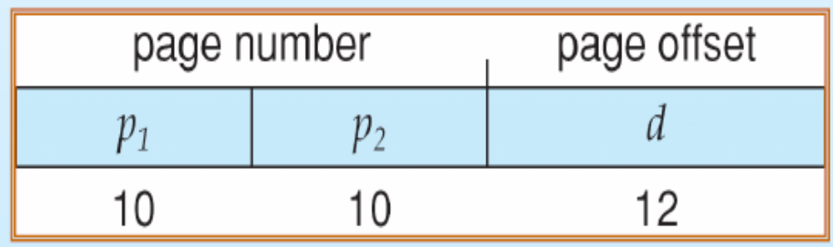
Pentium paging
The Pentium architecture allows a page size of either 4KB or 4MB.
For 4KB pages, the Pentium uses a two level paging scheme in which division of the 32 bit linear address as:

Slide 43
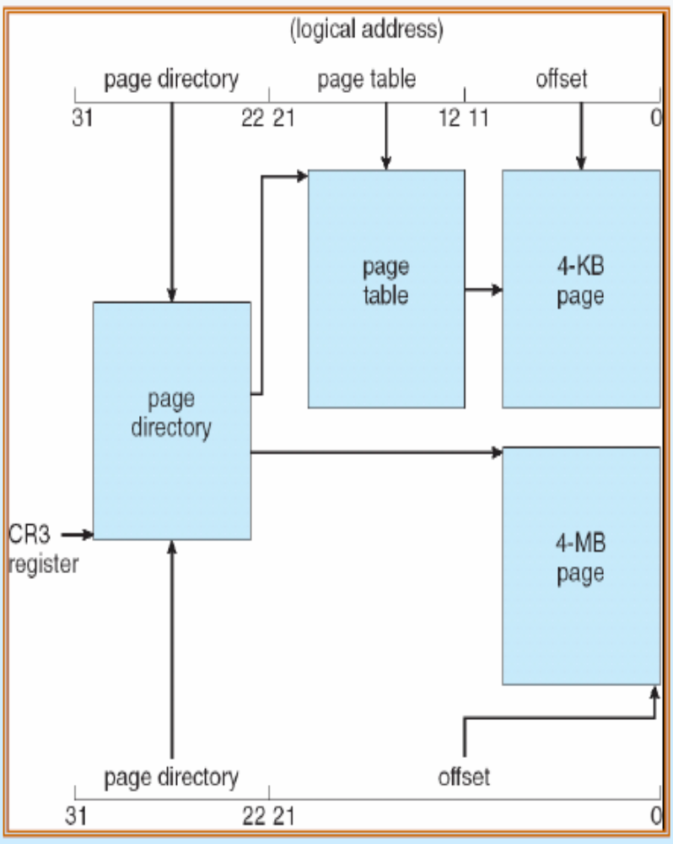
Pentium paging

Slide 44
Linux on Pentium System
Although the Pentium uses a two-level paging model, Linux is designed to run on a variety of hardware platform, many of which are 64-bit platforms
Therefore, two-level paging is not plausible
Thus, Linux has adopted a three level paging strategy that works well for both 32-bit and 64-bit architectures

Slide 45

Linux on Pentium System
The linear address is Linux is broken into the following four parts:
The number of bits in each part varies according to architecture
How does Linux apply its three-level model on the Pentium? The size of middle directory is zero bits

